Slide 1

BY -
SOCIAL DISTANCING DETECTOR USING DEEP LEARNING
Shreyasi periketi (2451-19-733-173) Gandu Sahithya (2451-19-733-161)
Under the guidance of : A. Saritha Asst. Professor, CSED
Dr. K. Venu Gopal Rao Professor and Dean(Academics)
G. Vijay Kumar Associate Professor
PROJECT COORDINATORS :

Slide 2

CONTENTS
Abstract
Problem Statement
Proposed System
Scope of Mini-project
Hardware & Software requirements
Flow of Execution
UML Diagrams
Implementation
Results
Future Enhancements
Bibliography

Slide 3
ABSTRACT
In the fight against coronavirus, Social Distancing has proven to be an effective measure to hamper the spread of the disease. The system presented is for analyzing the Social distance by calculating the distance between people in order to break the spread of the virus. This system utilizes input from a video frame to figure out the distance between the individuals to alleviate the effect of this pandemic. This is done by evaluating a video feed obtained by a surveillance camera. The video is calibrated into bird’s view and fed as an input to the YOLOv3 model which is an already trained object detection model. The YOLOv3 model is trained using the Common Object in Context (COCO). The proposed system is corroborated on a pre-filmed video. The results and outcomes obtained by the system show the evaluation of the distance between multiple individuals and determine if rules are violated or not. If the distance is less than the minimum threshold value, the individuals are represented by a red bounding box, if not it is represented by a green bounding box. This system can be further developed to detect social distancing in real time applications.

Slide 4
PROBLEM STATEMENT
The novel coronavirus (Covid-19) pandemic emerged in December,2019. The spread of the virus has left the public shocked. The World Health Organization (WHO) has declared Covid-19 as a pandemic due to the increase in the number of cases reported around the world. To stop the pandemic, many countries have implemented a lockdown where the government forced the citizens to stay at home during this critical period and made it clear that the most effective way to slow down the spread of Covid-19 is by avoiding close contact with other people. To break the chain of Covid-19 pandemic, the citizens around the world are practicing Social distancing. In reducing the impact of this coronavirus pandemic, practicing social distancing and self-isolation have been one of the most effective ways to break the chain of infections after restarting the economic activities. In fact, it has been observed that there are many people who are ignoring public health measures, especially with respect to social distancing. It is understandable that given the people’s excitement to start working again, they sometimes tend to forget or neglect the implementation of social distancing. Hence, this work aims to facilitate the enforcement of social distancing by providing automated detection of social distance violation in workplaces and public areas using a deep learning model. In the area of machine learning and computer vision, there are different methods that can be used for object detection. These methods can also be applied to detect the social distance between people.

Slide 5
PROPOSED SYSTEM
The social distancing detector is developed to detect the safety distance between people in public spaces. The deep CNN method and computer vision techniques are employed in this system. Initially, an open-source object detection network based on the YOLOv3 algorithm is used to detect the pedestrians in the video frame. From the detection result, only the pedestrian class is used and other object classes are ignored in this application. Hence, the bounding box best fits for each detected pedestrian can be drawn in the image, and this data of detected pedestrians will be used for the distance measurement. For camera setup, the camera is captured at a fixed angle as the video frame, and the video frame is treated as a perspective view. Now, accurate estimation of distance measurement is done. It is assumed that the pedestrians in the video frame are walking on the same flat plane. Four filmed plane points are selected from the frame and then transformed into the top-down view. The location for each pedestrian can be estimated based on the top-down view. The distance between pedestrians can be measured and scaled. Depending on the pre-set minimum distance, any distance less than the acceptable distance between any two individuals will be indicated with red lines that serve as precautionary warnings. The system is implemented using the Python programming language.

Slide 6
SCOPE OF MINI-PROJECT
The word “social distancing” is best practice in the direction of efforts through a variety of means, aiming to minimize or interrupt the transmission of COVID-19. It aims at reducing the physical contact between possibly infected individuals and healthy persons. As per the WHO, it is prescribed that people should maintain at least 6 feet of distance among each other in order to follow social distancing. A recent study indicates that social distancing is an important measure and essential to prevent SARSCoV-2, because people with mild or no symptoms may unknowingly carry corona infection and can infect others.
In the present project, a deep learning based framework is proposed that utilizes object detection and tracking models to be used in the social distancing detector for dealing with the increase of COVID-19 cases. In order to maintain the balance of speed and accuracy, YOLO v3 is utilized as object detection and tracking approaches while surrounding each detected object with the bounding boxes. Later, these bounding boxes are utilized to compute the efficient vectorized representation for identifying the clusters of people not obeying the order of social distancing.

Slide 7
HARDWARE & SOFTWARE REQUIREMENTS
Hardware requirements : ● Processor - Intel i5 or above ● Device - Any device that can access the internet. ● Space on disk - minimum 1000MB ● 8GB RAM ● Hard disc 10GB or above
Software requirements : ● Platform - Windows 8 or above ● Technology - Deep Learning ● Operating System - Any OS with clients to access the internet. ● Packages - All machine learning files and libraries to perform the project. ● Programming Language - Python ● Editor - Command Prompt / IDLE Visual Studio

Slide 8
LIBRARIES
Numpy
Cv2
Argparse
Imutils
openCv
Scipy

Slide 9
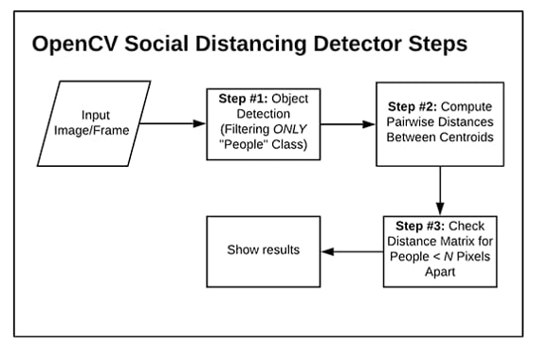
FLOW OF EXECUTION

Slide 10
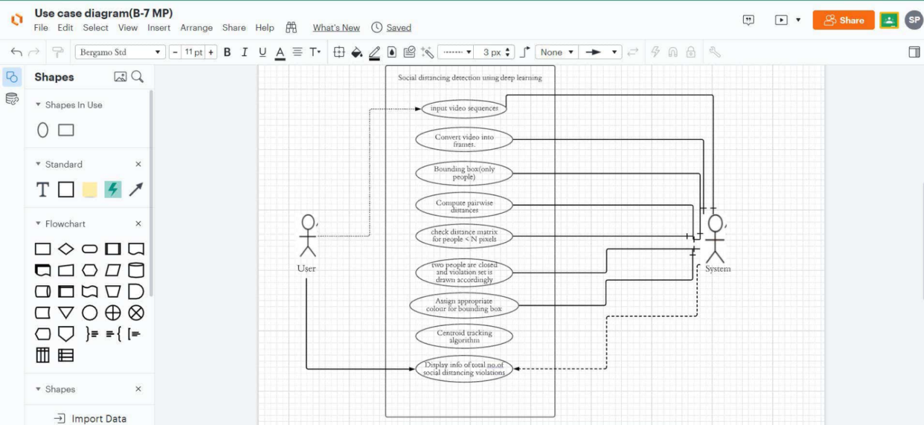
UML DIAGRAMS

Slide 11
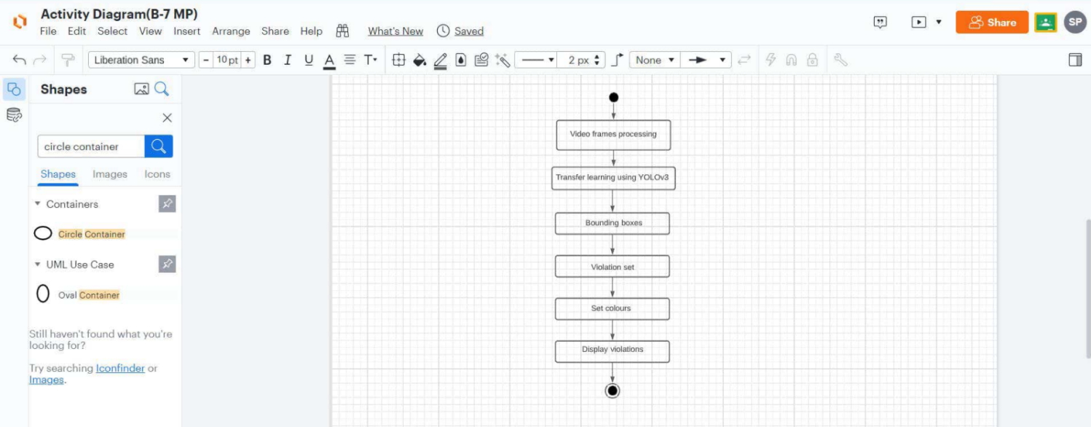

Slide 12
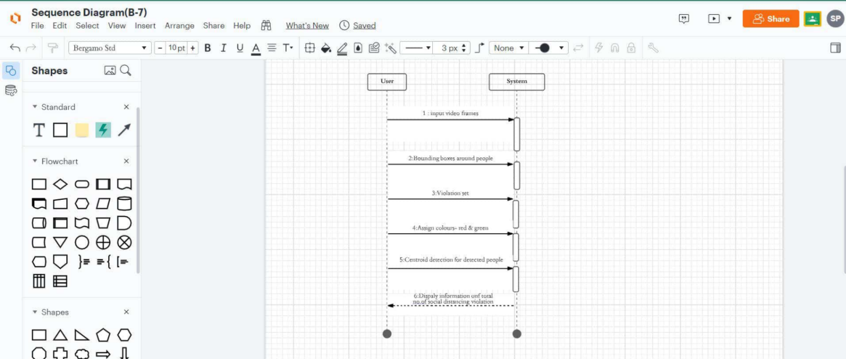

Slide 13
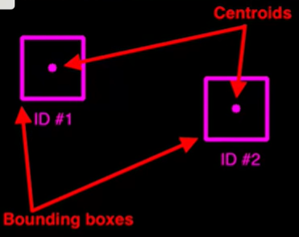
IMPLEMENTATION
This project is based on three Algorithms : 1. Object Detection 2. Object Tracking 3. Distance measurement between the detected objects.
We are using the YOLO Object Detection Transfer Learning process. YOLO can detect over 9000 classes. We are using a coco dataset which consists of 80 classes. After detection of the object, we have to apply object tracking i.e. after detecting a person, we have to track him/her. We will assign a video frame and draw a bounding box around the object and measure the centroids of the box. In the example, we have taken a video frame and drew boxes to measure the centroids.

Slide 14
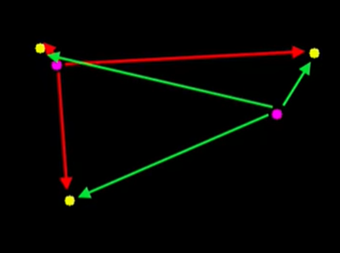
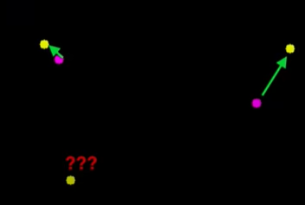
In the next frame every yellow dot nearest to the purple dot is the new centroid. And, we have another new centroid depicting a new person into the frame. We calculate the distance of each point from every point.
By calculating the distance of each point from every point, we take the Euclidean distance from every point and close centroids are detected as the same person i.e, a person is moving from one point to the other in the frame and a new person enters the frame.

Slide 15
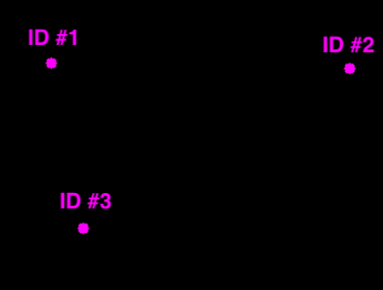
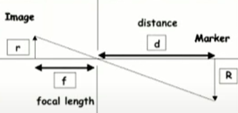
Now we have a clear frame which can detect the people moving from one point to the other point as well as the news ones who entered the frame. In this frame, IDs are assigned to the boxes as shown.
For the Distance measurement,
we take people as objects and a surveillance camera is at a fixed distance to measure the distance.
The representations are given as : Marker : It is the distance from the object to camera f : Camera’s focal length P : pixel covered in the camera d : Distance W : Object wide Focal length is given by, f = (P x D)/W Using this focal length, we can calculate the distances as : d = (W x f)/P

Slide 16
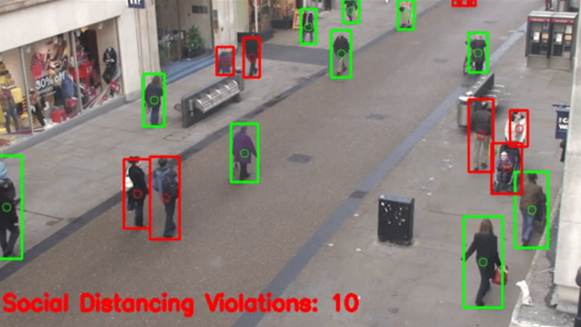
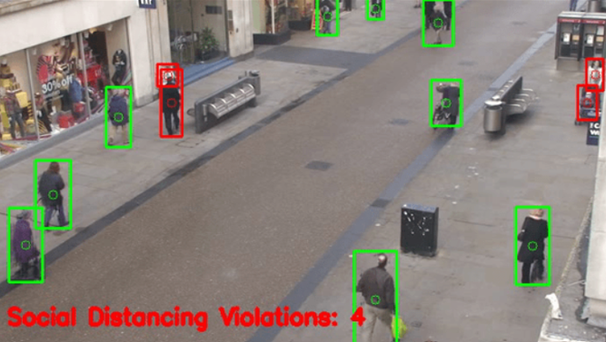
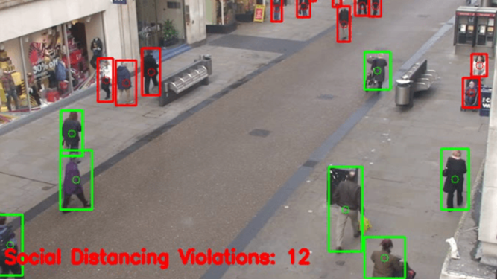
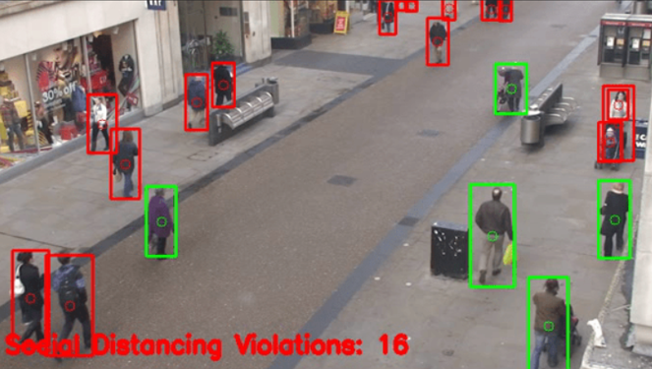
RESULTS/OUTPUTS

Slide 17
FUTURE ENHANCEMENTS
The project explains an efficient real-time deep learning based framework to automate the process of monitoring the social distancing via object detection and tracking approaches, where each individual is identified in the real-time with the help of bounding boxes. The generated bounding boxes aid in identifying the clusters or groups of people satisfying the closeness property computed with the help of pairwise vectorized approach. The number of violations are confirmed by computing the number of groups formed and violation index term computed as the ratio of the number of people to the number of groups. Since this approach is highly sensitive to the spatial location of the camera, the same approach can be fine tuned to better adjust with the corresponding field of view.
Furthermore, the work can be further improved by optimizing the pedestrian detection algorithm, integrating other detection algorithms such as mask detection and human body temperature detection, improving the computing power of the hardware, and calibrating the camera perspective view.

Slide 18
BIBLIOGRAPHY
● towardsdatascience.com/object-detection-using-yolo3-and-openCV
● pythonbasic.org
● realpython.org
● pyimagesearch.com
● github.com/openshot-qt/wiki
● packaging.python.org/en/latest/installing-using-pip-and-virtual-environments
● github.com/social-distancing-detection-in-real-time/blob/main/README.md
● educative.io/edpresso/how-to-activate-virtualenv-windows

